Slide 1
Writing Something of Your Own: Confronting “The Time Lie”
Lori Rogers and Dr. Judy Tarbox

Slide 2
Developing an Article for Publication or Presentation in Two Hours. Flat.
This session provides a step-by-step guide for creating professional papers and conference presentations from ideas and drafts that may have been set aside by the lie: “I have no time to write. I’m too busy grading other people’s writing.”
Sound familiar? Let’s get started.

Slide 3

The Right to Write
Julia Cameron
“The obsession with time is really an obsession with perfection. We want enough time to write perfectly. We want to write with a net under ourselves, a net that says we are not foolish spending our time doing something that might not pay off.”
Julia Cameron; “The Time Lie”

Slide 4
Publication and Presentation Possibilities
Conferences and Journals
American Reading Forum
Association of Literacy Educators and Researchers
Write to Learn
National Writing Project
National Council for Teachers of English (NCTE)
Conference on English Leadership (CEL)
Two-Year College English Association (TYCA)
Conference on College Composition and Communication
Society for Information Technology and Teacher Education (SITE; conference & several journals)
https://ncte.org/resources/journals/https://ncte.org/resources/journals/https://ncte.org/resources/journals/

Slide 5
Steps to Begin: Building from your ‘Wheelhouse’ or Finding Something New

Slide 6
Building on Previous Work
Pivoting Approaches; Applying New Research; and Committing to Completion
Identify papers, projects, personal writings, or previous research you could build from and begin:
Pivoting the focus to new communities, contexts, or conclusions
Applying new methods of primary research or new evidence from secondary sources
Developing collaborations and commitments to finish what you started…!

Slide 7
Finding New Areas of Interest
What don’t I know?
What don’t I buy?
What/who/where is missing?
Why does this interest me?
Where do I fit in (teaching, service, hobbies, ideologies)?
Identify “conversations” within your field to explore both current and constant areas of research & writing.
Isolate those conversations you are most interested in and ask yourself:

Slide 8
Identifying Your Focus:
Start Small Before Building Big
Narrow your focus by isolating with time-worn categories:
age; gender; race/ethnicity; region; class; sexual identity/orientation; time; and ideology
Broaden your now narrower focus by considering:
larger context
Interdisciplinary connections
Across-the pond connections

Slide 9

Research Options
Primary and Secondary Research

Slide 10
Articulating a Claim: Resources for Yourself and Your Students
Writing Problem Statements with Research
https://youtu.be/iaGpj8ViH1w?si=EeCWbL9JSOSLvPzbttps://youtu.be/iaGpj8ViH1w?si=EeCWbL9JSOSLvPzb
Writing Strong Thesis Statements
https://youtu.be/-e2EthZC0aU?si=vkntaFquPzLR-Ul9

Slide 11
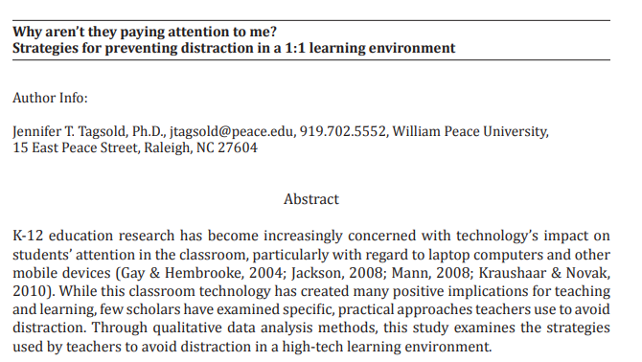
Building to Your Abstract
What’s Required?
Your thesis
Your methods: detailed primary research and reference to foundational secondary sources
Your conclusions and implications
https://owl.purdue.edu/owl/graduate_writing/graduate_writing_genres/graduate_writing_genres_abstracts_new.html

Slide 12
Making a Plan: Steps to Finishing
1.
2.
3.
4.
5.
6.

